Slide 1
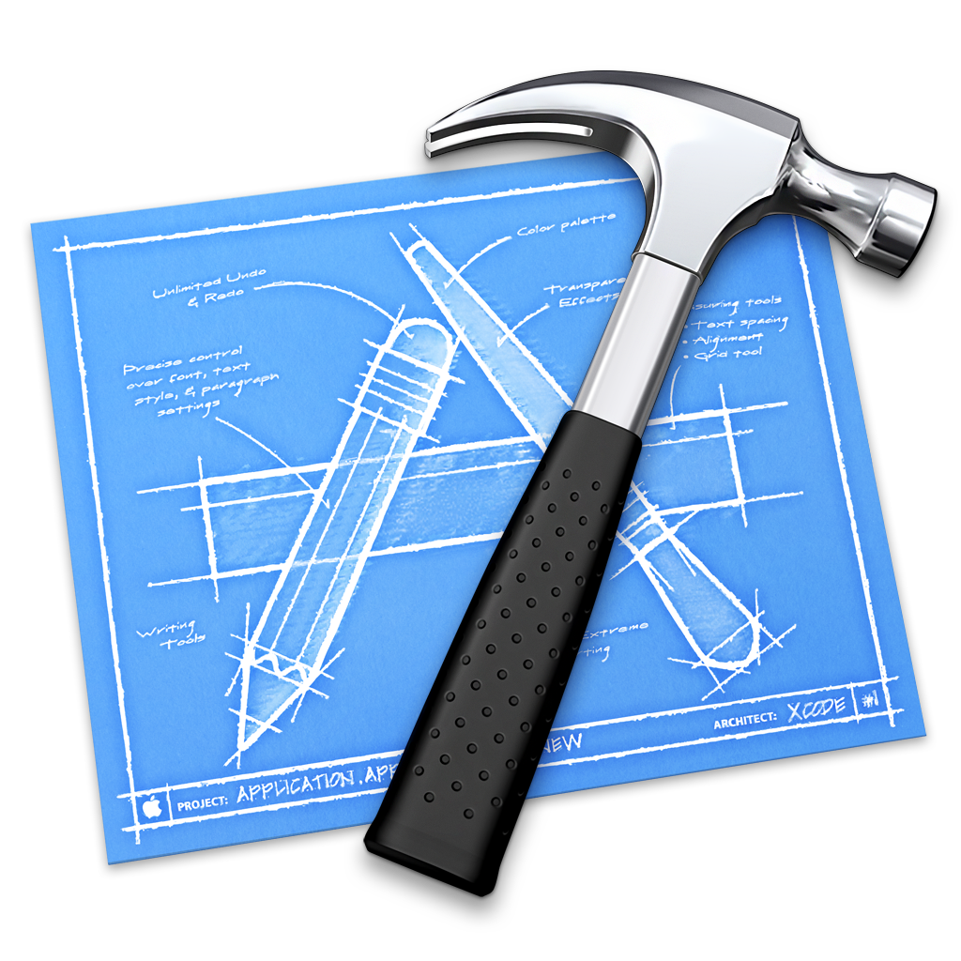
Core Data
ElectronicArmory.com

Slide 2
What is a Database?
A relational database allows related objects to be represented in a way that is fast to recall.
Student objects can be related to a number of courses, namely those which they are taking. A courses can be related to students, namely the ones who are taking that course.

Slide 3
Database terminology
One-to-one - One object relates to exactly one other object. Ex: A person has one spouse, and vice versa.
One-to-many or many-to-one - One object relates to many others or the other way around. Ex: A person has many possessions.

Slide 4
Database terminology
Many-to-many - An object relates to many others and the other way around. Ex: A student takes many courses. Many courses have many students.

Slide 5
Database Terminology
Tables or Entities - Is an object that has several fields/attributes/columns. Ex: A student entity has a first name, last name and list of courses he/she is taking.
Column or attribute - An object’s properties or fields. Ex: First name, last name, age.

Slide 6
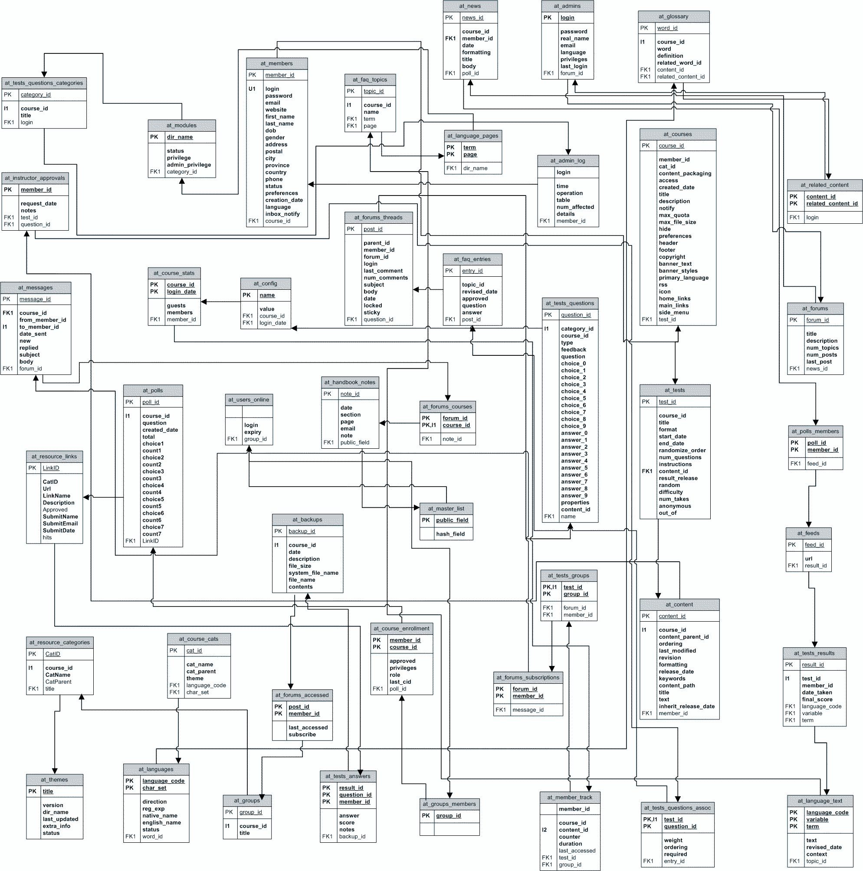
Example Database Schema

Slide 7
What is Core Data?
Several technologies that enable the storage of large amounts of data, efficiently, as well as the efficient and filtered recall of that data.

Slide 8
Core Data Features
Change tracking and undo support.
Relationship maintenance.
Futures (faulting).
Automatic validation of property values.
Schema migration.
Optional integration with the application’s controller layer to support user interface synchronization.
Full, automatic, support for key-value coding and key-value observing.
Grouping, filtering, and organizing data in memory and in the user interface.
Sophisticated query compilation.(NSPredicate)
Merge policies.

Slide 9
Why Use Core Data
Code is 50-70% smaller
Built in, optimized and tested code
Mature (announced at WWDC 2005)
If apps requires data with complex relationships or serializing is too expensive

Slide 10
What Core Data is not
Not a relational database
Not a end-all, be-all (but close)

Slide 11
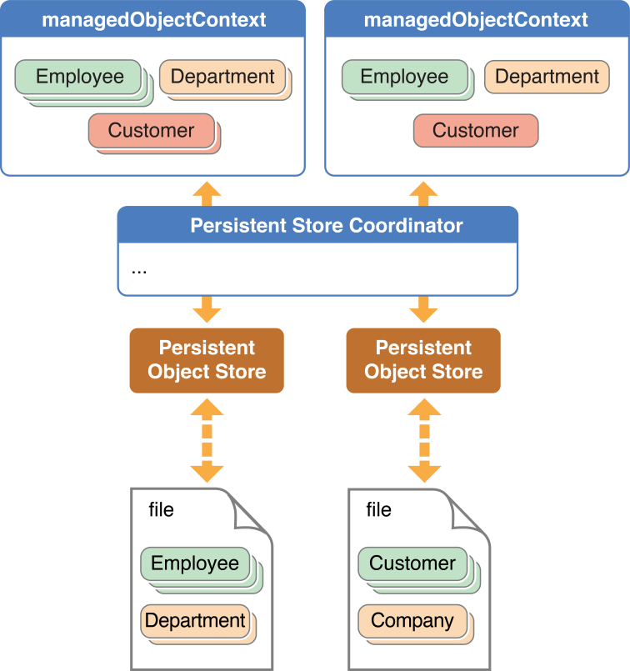

Slide 12
Core Data Terminology
Persistent Store - the data storage object (SQLite, binary, XML)
Persistent Store Coordinator - Handles loading and control of the persistent store

Slide 14
Core Data Terminology
Managed Object Model - Definition of our models
Managed Object - An object in Core Data
Managed Object Context - an intelligent scratch pad

Slide 15
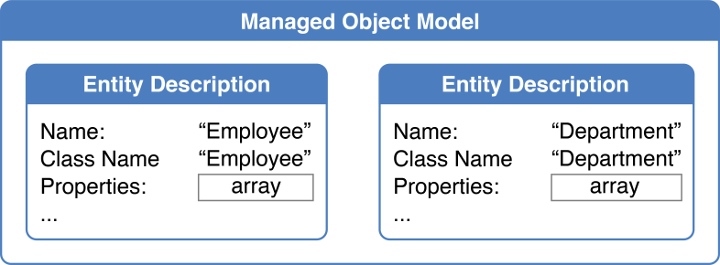
Managed Object Model

Slide 17
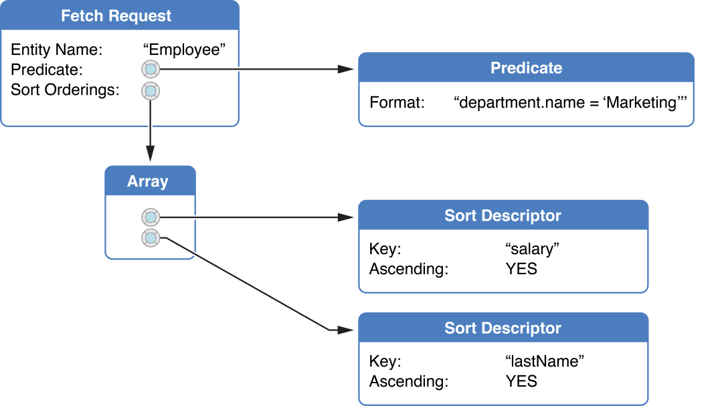
Fetching Data

Slide 18
NSEntityDescription
Description of your entity.
Use it to insert or reference managed objects.

Slide 19
Core Data
Demo

